Slide 1
CPUs vs GPUs vs ASICs
There are different types of mining hardware that miners use to solve the cryptographic hash puzzle.
1. CPUs = Central Processing Unit:
The main microchip inside our laptops or computers that's where everything goes through and that's where they get executed.
It's the center of operations for our computer.
It’s in charge of lots of different things and therefore it's very general in its nature
It can do very sophisticated things.
The general nature of the CPU means it's not specialized to one specific thing.
It can calculate the SHA-256 Hash and when compared to a human its very fast.
But it is limited to about 10 million hashes per second.

Slide 2
So 10 million hashes per second compared to human terms is super fast but in terms of the overall hash rate of for example the Bitcoin Network it’s not that much because the hash rate there is about millions of trillion hushes per second.
2. GPU=Graphical Processing Unit:
It's the specialized basic unit in the graphics card (video card) in our laptops or computers.
It is specialized because it is designed to work with graphics and operations that is specialized for matrix operations.(Parallel Computations)
Matrix operations is a benefit for hash calculations, GPUs are more efficient than CPUs for hash calculations because they don’t have many functionalities to perform like the CPUs, and also GPUs specialty in matrix operations enable it to perform hash calculations much faster than CPUs.
GPUs can perform up to 1 Billion hash per second.

Slide 3
3. ASIC= Application Specific Integrated Circuit:
ASICs Devices are totally specialized and designed to solve the SHA-256 hash.
The integrated circuit of the ASIC device is designed in such a way that the device doesn't have to perform any operation that depends on the logical level such as put this bit here and these two bits there, and divide this by this and so on, this happens in the CPU or the GPU.

Slide 4
The ASIC device just relies exclusively on its circuit to perform that calculation so as electricity runs through the device, and just because of the architecture of the device the calculation is performed.
ASICs perform the hash calculations directly using its physical level rather than on the logical level.
ASICs can achieve an incredible speed of more than 1000 Giga Hashes per second or more than trillion hashes per second.
billion means a thousand millions (1,000,000,000 which is 10⁹), trillion means one thousand billions (10¹²),

Slide 5
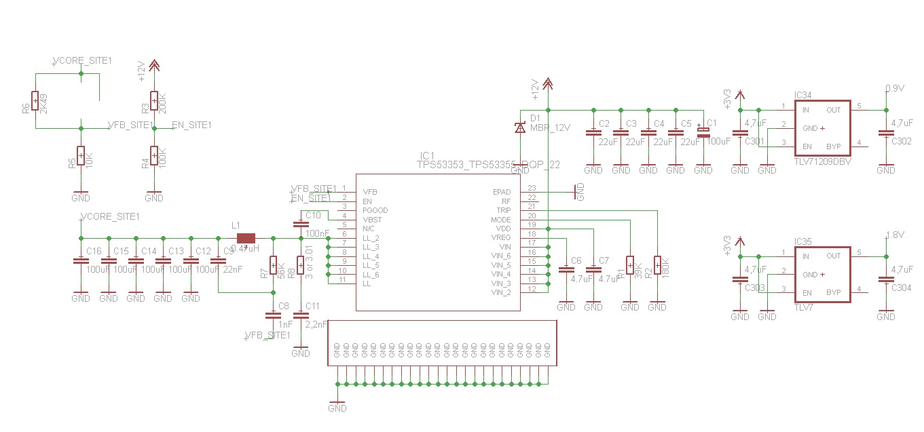

Slide 6
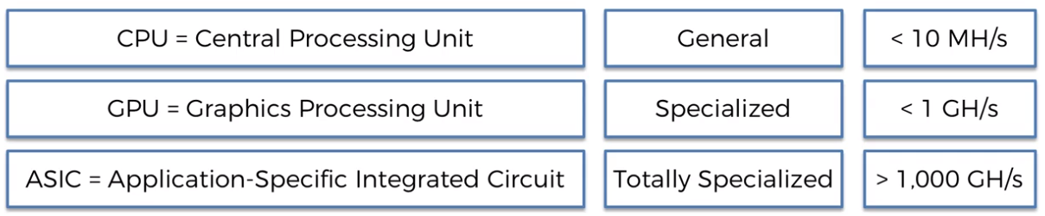

Slide 7
Cloud Mining
Cloud Mining: Miners rent equipment somewhere far away and they pay a fee in order to participate in mining. Miners pay a fee in order to use someone else's equipment such as a super computer, cloud computing, or cloud storage.
Not all cryptocurrencies works with GPUs or ASICs.
BTC works fine with ASICs because ASICs are designed to calculate the SHA-256 which is the base for BTC.
Other cryptocurrencies don’t use SHA-256 they use different hash so they cant use ASICs.

Slide 8
Nowadays, GPUs are outdated for BTC, BTC miners use ASICs instead.
Different cryptocurrencies use different hash functions, so when comparing the hash rate between different cryptocurrencies you should know what is the hash function used and how difficult it is.

Slide 9
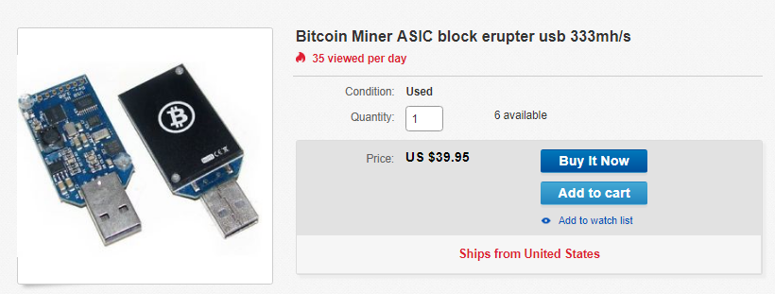
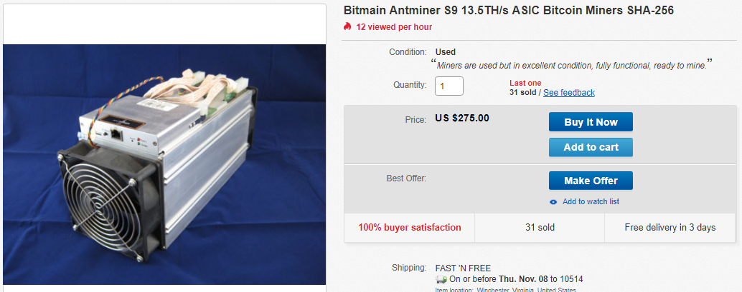

Slide 10
How Do Mempools Work??
How mempools function in a distributed peer to peer system?
The network consists of nodes and each node represents a miner or simply people computers who want to transact on the network (send each other bitcoins or any other cryptocurrency).
There is a mempool for each participant whether it's a node or a miner.

Slide 11



Slide 12
This is a distributed peer to peer network where the whole concept of Blockchain is about, so there is nothing Central about it including the mempool.
The mempool has to be individual to every single participant, and the mempool is a staging area for transactions.
On the Bitcoin blockchain, blocks are added once every 10 minutes, but we can transact with each other more frequently. We don't have to wait and transact once every 10 minutes, we can transact at any point in time.
So the mempool acts like a temporary storage area where these transactions go before they're added to a block.

Slide 13
If some user on the network want to send some money to somebody (transaction), then the user transaction get added to his mempool, then that gets broadcasted or relayed across the network.
The transaction relayed to the closest nodes including miners and then that transaction gets added to their mempools.
There’s many checks that are conducted by every single node to make sure that it's a valid transaction and it's not fake.
And then they relayed further down the network and that transaction gets added to every single mempool in the network.

Slide 17
Typically, throughout the day a mempool can store about 8000 to 10000 transactions at any given point in time.
A block can contain about 2000 transactions which is limited by the size of the block which is one megabyte, so a block can contain about two thousand transactions depending on the size of the transactions.
At any point of time the miners are mining the blocks, at some time one of the miners will find the valid cryptographic hash and will add the block to the blockchain.

Slide 18
While the miners were mining the block in the process, they had already selected the transactions to be added to the block, so they have the block configuration even before they have successfully mined the block.
When the block has been mined, then it's time to take these transactions out of the mempool because they're already in the block , then that block gets relayed across the network for checking.
As long as the block passes the checks and become a member in the network, then other miners can remove the same transactions from their mempools.

Slide 23
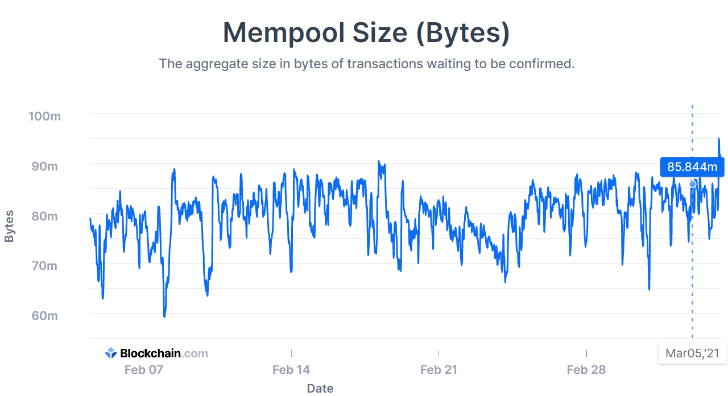
“The mempool is where all the valid transactions wait to be confirmed by the Bitcoin network. A high mempool size indicates more network traffic which will result in longer average confirmation time and higher priority fees.”

Slide 24
ORPHANED BLOCKS

Slide 25
Detached or Orphaned blocks are valid blocks which are not part of the main chain. They can occur naturally when two miners produce blocks at similar times or they can be caused by an attacker (with enough hashing power) attempting to reverse transactions.
What happens is at that point in time, two versions of the chain will exist, one miner will have a chain with a newly added block and another miner will have chain with their newly added block too.
Both miners will continue trying to grow their chains.
The nodes in the network which are close to the first miner will have been relayed the chain with newly added block by the first miner, and the same for the second miner will happen too.
There will be two competing networks of two competing chains at the same time.

Slide 26
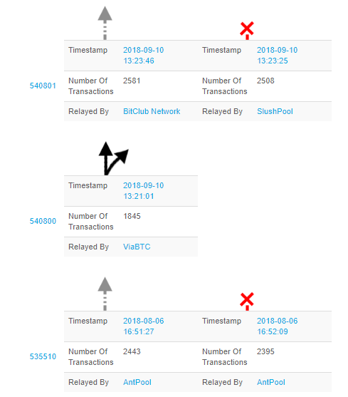

Slide 27
And what happens from there is that whoever builds on the next block they eventually will be the winner, because the golden rule says the longest chain wins.
So whoever builds the next block first will take over the chain unless they build on the next block at the same time again and then it will be who builds the next block wins.
Basically whoever has more hashing power out of the two competing chains will win eventually. Which means it does not matter who mined the block first, what matters is who added more blocks on top of the block in dispute (have longer chain).
The solution is built on the Byzantine general problem and the consensus protocol of the blockchain, a consensus will be reached as long as we have 51 percent of the hashrate on one side.
The transactions that were in the orphaned block get released back into the mempools of the nodes which accepted this block.

Slide 28
If some transactions were selected by the two competing chains, then once they got released from the losing chain to their corresponding mempools then it will be removed since its already exist in the wining chain.
For the transactions that were selected by the losing mempool only, after they got released to their corresponding mempools they have to wait until selected again by a new miner.

Slide 29
It's always important to wait at least for 6 confirmations before considering your transaction to be successful.
Confirmation means several blocks on top of the current block has been added.
If a transaction ended up in one of the orphaned blocks and the seller didn’t wait for several blocks for confirmation, then a double spend problem might occur.

Slide 30
The 51% Attack
It's a hypothetical attack that it could possibly happen.
People who work in blockahain and miners discuss this attack because of the consequences that it can have.
The 51% attack IS NOT an attack designed to tamper with an individual or selected blocks.

Slide 31

The 51% attack is not about tampering with one block or set of blocks

Slide 32
If someone hypothetically will tamper with some block, then the attacker must hack into the computer or node on top of the targeted block, also the attacker have to hack into all the following blocks in the blockchain because all of the blocks are linked using the previous hash.
Also the attacker have to rehash all the blocks that follow the target block on many different computers including miners and non miners nodes in the network.
To do so, the hacker should have at least 51% of the network hashrate which is impossible to happen.

Slide 33


So what is the 51% Attack??
Assume we have a group of miners who mine some cryptocurrency and they have their own blockchain.
A new group of miners appear to join the first group claiming they want to mine their cryptocurrency, but actually what they want is to have a copy of their blockchain, by the time the new group join the old group the chain contains the newest block that were added to the blockchain.

Slide 34



Slide 35
After the new group have copied the chain of the old group, the new group isolate itself intentionally from the rest of the network (old group network) and they don’t send or receive any messages with them.
Now both networks continue mining their own version of the chain without exchanging any information with each other, the old network adds some new blocks to its chain, and the new network adds new blocks to their version of the chain, but the new networks adds more blocks than the old network because their hash power is larger than the older network.

Slide 37
After some time the new group of miners open up the seal and they get connected to the old network and they start broadcasting messages to the old network.
What happens now is that we have one full network with two competing chains.
The rule states that if there are two competing chains then the longest chain wins and the shorter chain blocks that are different from the longest one are considered invalid.

Slide 39
As a result the old group chain have to be replaced with new group chain, by removing all the blocks that is different than the new group chain.
By removing the different blocks, all transactions that was confirmed by these blocks have to be released to the mempools again.
Notice that nothing illegal happened so far, no computer was hacked and no hash value was tampered with.
So what is wrong with this???

Slide 40
Consider the following scenario, before the new group of miners joining the old group, they start to act as customers (not miners) by buying very expensive goods (fancy cars, jewelry, fiat currency exchange, other cryptocurrencies) using the old group transactions.
After they bought the expensive goods they now form their new group of miners and join the old group network as miners this time and they continue as we described before.
The sellers who sold the expensive goods are in trouble now, because their transactions were released to the mempools after the old group chain was considered invalid, and if what was sold is cryptocurrency then no one can track the buyers because they are anonymous.

Slide 41
When the old transactions were released to the mempools, the new group of miners will intentionally avoid selecting these old transactions again because they are more than 50% of the network.
The buyers simply had their goods and their money is released back to them and they are happy, they can ignore sending the money back to the sellers and they can spend their money again for different merchandises, and this is what is called double spend problem where someone can spend the same money more than one time.
The 51% attack is not possible to happen in BTC chain because the hash power of the network is tremendous, and no party can have 51% of the hash rate, but this scenario could happen with other light cryptocurrencies.

